Slide 1

:: Banking data mining case study
João Miguel Polónia Pascoal Faria
Márcio Filipe Vilela Fontes
Supervisor: Prof. João Pedro Carvalho Leal Mendes Moreira
Mestrado Integrado em Engenharia Informática e Computação
Faculdade de Engenharia da Universidade do Porto
January 6, 2016

Slide 2
#1
CRISP-DM
Notes:
Health Problems (stress, pollution, etc.) -> related with environment
Economic impact
Environmental impact

Slide 3
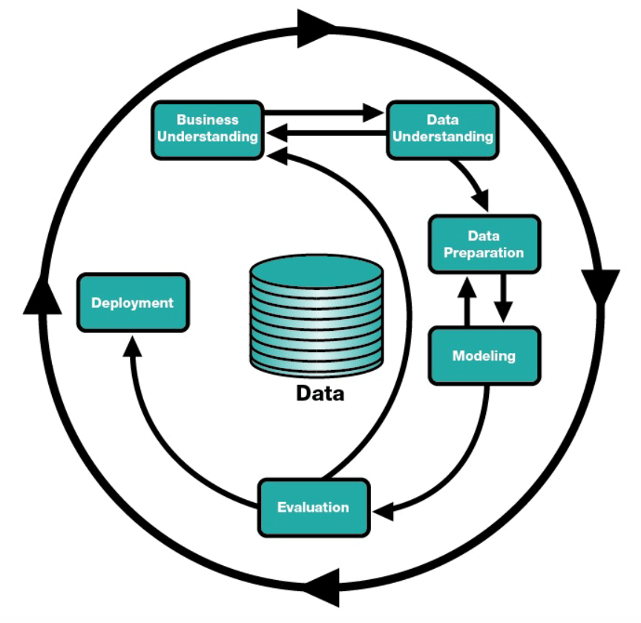
#CDM
CRISP-DM
Notes:
Health Problems (stress, pollution, etc.) -> related with environment
Economic impact
Environmental impact

Slide 4
#2
Domain description
Notes:
Health Problems (stress, pollution, etc.) -> related with environment
Economic impact
Environmental impact

Slide 5
#DD
Domain description
Topic
Data about banking operations of a regular bank, containing information about clients, loans, transactions and credit cards;
There is also demographic data to help understanding the environment;
The bank wants to improve their understanding of customers in order to perform actions and to improve its services.
Descriptive Goals
Study the clients, concerning their loans (amounts and durations), transactions, etc. to formulate a process to achieve the predictive goal;
Study the environment to understand the type of clients the bank should target, the districts where they are located, etc.
Predictive Goal
Determine whether a loan will end successfully.
Notes:
Health Problems (stress, pollution, etc.) -> related with environment
Economic impact
Environmental impact

Slide 6
#3
Exploratory data analysis
Notes:
Health Problems (stress, pollution, etc.) -> related with environment
Economic impact
Environmental impact

Slide 7
#EDA
Data preparation
Extract implicit knowledge
Extract birthdate and gender from birthnumber (Clients relation)
Extract age from birthnumber (note: assume 2016 as current year)
Complete missing values
District Jesenik had missing values (unemployment rate 1996 and crimes in 1996)
These ones were replaced by the median of all other districts
Extract useful information from transactions
Accounts with history of sanctions
Discretization
Use of these of techniques for converting quantitative to qualitative
Notes:
Health Problems (stress, pollution, etc.) -> related with environment
Economic impact
Environmental impact

Slide 8
#4
Descriptive data analysis
Notes:
Health Problems (stress, pollution, etc.) -> related with environment
Economic impact
Environmental impact

Slide 9
#DM
Gender distribution
Notes:
Health Problems (stress, pollution, etc.) -> related with environment
Economic impact
Environmental impact

Slide 10
#DM
Average Salary per District
Notes:
Health Problems (stress, pollution, etc.) -> related with environment
Economic impact
Environmental impact

Slide 11
#DM
Crimes and Unemployment increase
Notes:
Health Problems (stress, pollution, etc.) -> related with environment
Economic impact
Environmental impact

Slide 12
#DM
Credit cards distribution
Notes:
Health Problems (stress, pollution, etc.) -> related with environment
Economic impact
Environmental impact

Slide 13
#DM
Clients per Region
Notes:
Health Problems (stress, pollution, etc.) -> related with environment
Economic impact
Environmental impact

Slide 14
#DM
Loan amount comparison
Notes:
Health Problems (stress, pollution, etc.) -> related with environment
Economic impact
Environmental impact

Slide 15
#DM
Loan duration distribution
Notes:
Health Problems (stress, pollution, etc.) -> related with environment
Economic impact
Environmental impact

Slide 16
#DM
Client vs. Card Clusters (K-Means)
age | gender | card_type
-1.2302465 | 1 | 2
-0.3775839 | 0.25 | 0.1
-1.2061650 | 0 | 2
1.2849300 | 0.05 | 0.05
0.5920177 | 1 | 0.02777778
Notes:
Health Problems (stress, pollution, etc.) -> related with environment
Economic impact
Environmental impact

Slide 17
#DM
Client vs. Demography Clusters (K-Means)
age | inhabitants | ...
-0.011794711 | 2.1745980 | ...
0.008867357 | -0.1410296 | ...
0.054998006 | -0.3218908 | ...
-0.025915663 | -0.4892006 | ...
Notes:
Health Problems (stress, pollution, etc.) -> related with environment
Economic impact
Environmental impact

Slide 18
#DM
Client vs. Insurances Clusters (K-Means)
amount | n_entrepreneurs | crimes_96
0.6656325 | 1.8903740 | 2.4398930
0.4066814 | -0.7176040 | -0.4633185
-0.4444360 | 0.1075921 | -0.4689837
-0.1039707 | -0.6054897 | -0.2008185
Notes:
Health Problems (stress, pollution, etc.) -> related with environment
Economic impact
Environmental impact

Slide 19
#5
Predictive data analysis
Notes:
Health Problems (stress, pollution, etc.) -> related with environment
Economic impact
Environmental impact

Slide 20
#PM
Title
Notes:
Health Problems (stress, pollution, etc.) -> related with environment
Economic impact
Environmental impact

Slide 21
#6
Limitations and Future Work
Notes:
Health Problems (stress, pollution, etc.) -> related with environment
Economic impact
Environmental impact

Slide 22
#LFW
Limitations and Future Work
Limitations
The data is very old, so the potential applications of the predictions may not be useful;
If more data about the environment was gathered, better decisions could be taken (i.e. instead of having the average salary of a district, it would be more useful to have also the client’s salary);
There is a huge gap of instances between the successful and failed loans on the training spreadsheet.
Future Work
Perform a refinement of the algorithms used with real tests;
Use regression techniques to complement the Descriptive Modeling;
Test different and new prediction methods.
Notes:
Health Problems (stress, pollution, etc.) -> related with environment
Economic impact
Environmental impact

Slide 23
#7
Conclusions
Notes:
Health Problems (stress, pollution, etc.) -> related with environment
Economic impact
Environmental impact

Slide 24
#CC
Conclusions
It was possible to identify that the loan amount has a significant impact on the loan success;
It was possible to prove that the environment (scenarios of unemployment, high crime rate, etc.) of each client has significant impact on the insurance payments;
It was possible to find that the classic card owners are usually male and older people (this helps to focus on specific type of ads);
It was possible to conclude that the bank should target South Bohemia in order to get more clients;
It is suggested that the bank should “help” the clients which are unemployed with their loans, by reducing taxes for example, if the unemployment increase from 95-96 shall continue.
Notes:
Health Problems (stress, pollution, etc.) -> related with environment
Economic impact
Environmental impact

Slide 25
Notes:
Health Problems (stress, pollution, etc.) -> related with environment
Economic impact
Environmental impact

Slide 26
#8
Annexes
Notes:
Health Problems (stress, pollution, etc.) -> related with environment
Economic impact
Environmental impact

Slide 27
#AN
Data preparation
Disposition
Credit card (sanctions)
disp_id | client_id | account_id | type
1 | 1 | 1 | OWNER
2 | 2 | 2 | OWNER
3 | 3 | 2 | DISPONENT
card_id | disp_id | client_id | type | issued | account_id
117 | 649 | 649 | junior | 961123 | 539
786 | 5478 | 5478 | classic | 961231 | 4543
1164 | 12269 | 12577 | classic | 960812 | 10227
Account
Payment Orders
account_id | district_id | frequency | date
576 | 55 | monthly issuance | 930101
3818 | 74 | monthly issuance | 930101
704 | 55 | monthly issuance | 930101
order_id | account_src | date | bank | account_dst | amount | k_symbol
1 | 2 | 931105 | QR | 13943797 | 7266 | household
2 | 2 | 930905 | QR | 13943797 | 7266 | household
3 | 2 | 931205 | QR | 13943797 | 7266 | household
Notes:
Health Problems (stress, pollution, etc.) -> related with environment
Economic impact
Environmental impact

Slide 28
#AN
Data preparation
District
code | name | region | ratio_urban_inhabitants | unemployment_95 | unemployment_96 | crimes_95 | crimes_96
1 | Hl.m. Praha | Prague | 100 | 0.29 | 0.43 | 85677 | 99107
2 | Benesov | Central Bohemia | 46.7 | 1.57 | 1.85 | 2159 | 2674
3 | Beroun | Central Bohemia | 41.7 | 1.95 | 2.21 | 2824 | 2813
Client
client_id | birth_number | district_id | year | month | day | gender
1 | 706213 | 18 | 1970 | 12 | 13 | f
2 | 450204 | 1 | 1945 | 02 | 04 | m
3 | 406009 | 1 | 1940 | 10 | 09 | f
Notes:
Health Problems (stress, pollution, etc.) -> related with environment
Economic impact
Environmental impact

Slide 29
#AN
Decision Tree – Loan success (amount, salary, duration)
Notes:
Health Problems (stress, pollution, etc.) -> related with environment
Economic impact
Environmental impact

